Slide 1
Objects for Spatial Projects

Slide 2
Table of Contents
Basics
-What are Objects? Slide 3
-Types of Objects Slide 5
Simple 3D Objects
-Creating Simple 3D Objects Slide 6
3D Models
-Finding 3D Models Online Slide 10
-Object Compatibility with Unity Slide 11
-Creating 3D Models Slide 13
-Importing 3D Models Slide 14
Spatial Objects
-Types of Spatial Objects Slide 18
-Interactable Objects Slide 21
-Spatial Prefab Objects Slide 25

Slide 3
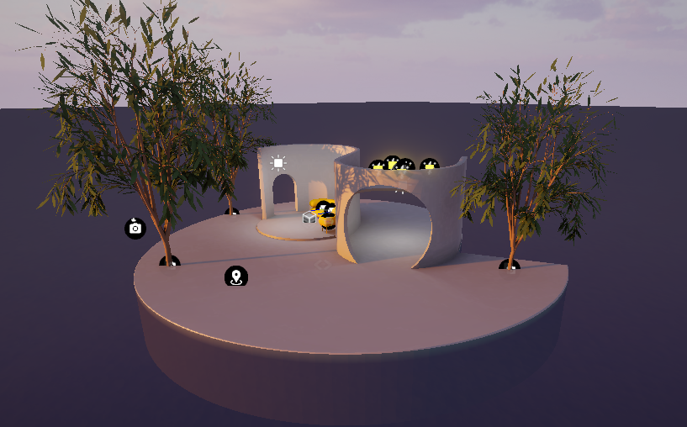
Basics What are Objects?
When making a scene for Spatial in Unity, everything in your scene is represented by objects.
Objects are the landscapes, buildings, furniture, and items that you see in a scene, as well as the cameras and lights that help you render the scene.
Spatial Island – Everything you see here is an object, on some level.

Slide 4
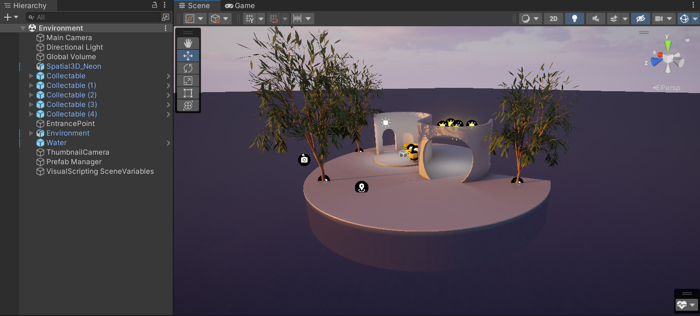
Basics What are Objects?
In Unity, all of the objects in your scene are listed in the Hierarchy (on the left by default).

Slide 5
Basics Types of Objects
Most scenes will have many different kinds of objects. These include:
Simple 3D objects
3D models
Spatial objects
Empty objects
Cameras
Lights

Slide 6
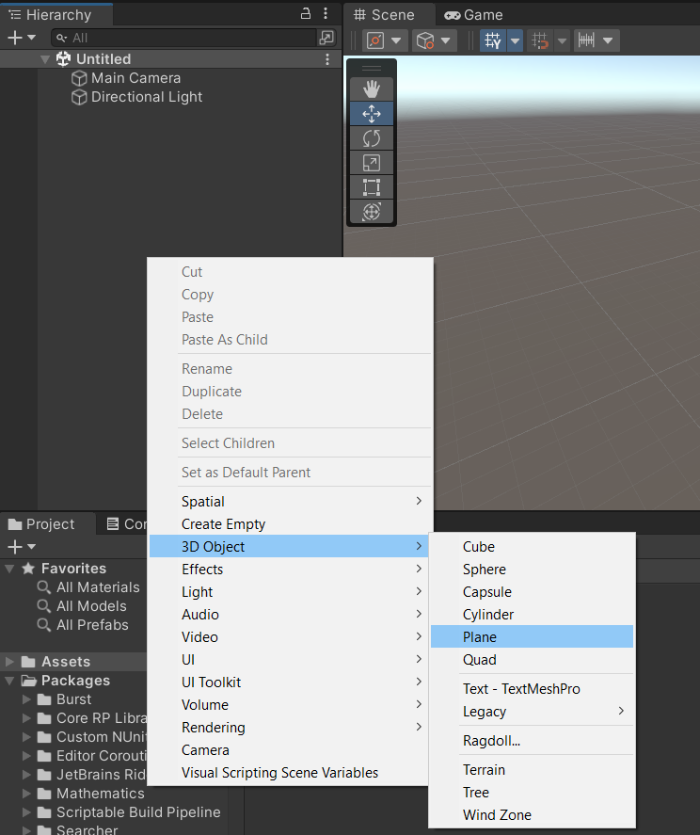
Simple 3D Objects Creating Simple 3D Objects
Creating simple 3D objects is quite easy.
Right click in your Hierarchy and go down to the 3D object tab. There you will find the different kinds of simple 3D objects.

Slide 7
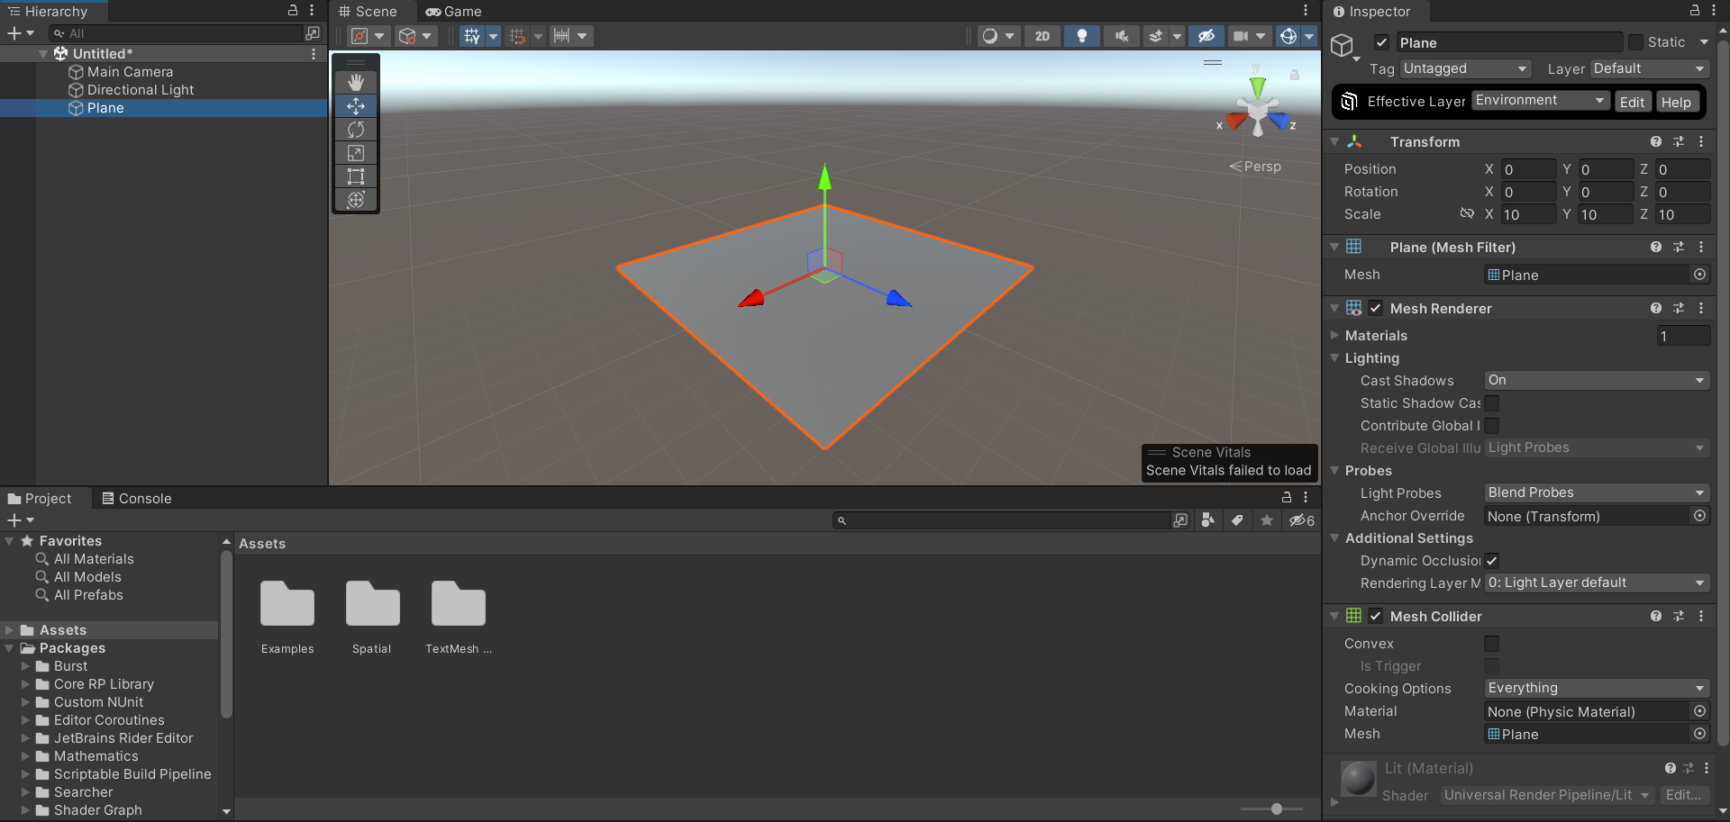
Simple 3D Objects Creating Simple 3D Objects
Simple 3D objects can be quite plain at first, but we can spice it up by adding a material to it.

Slide 8
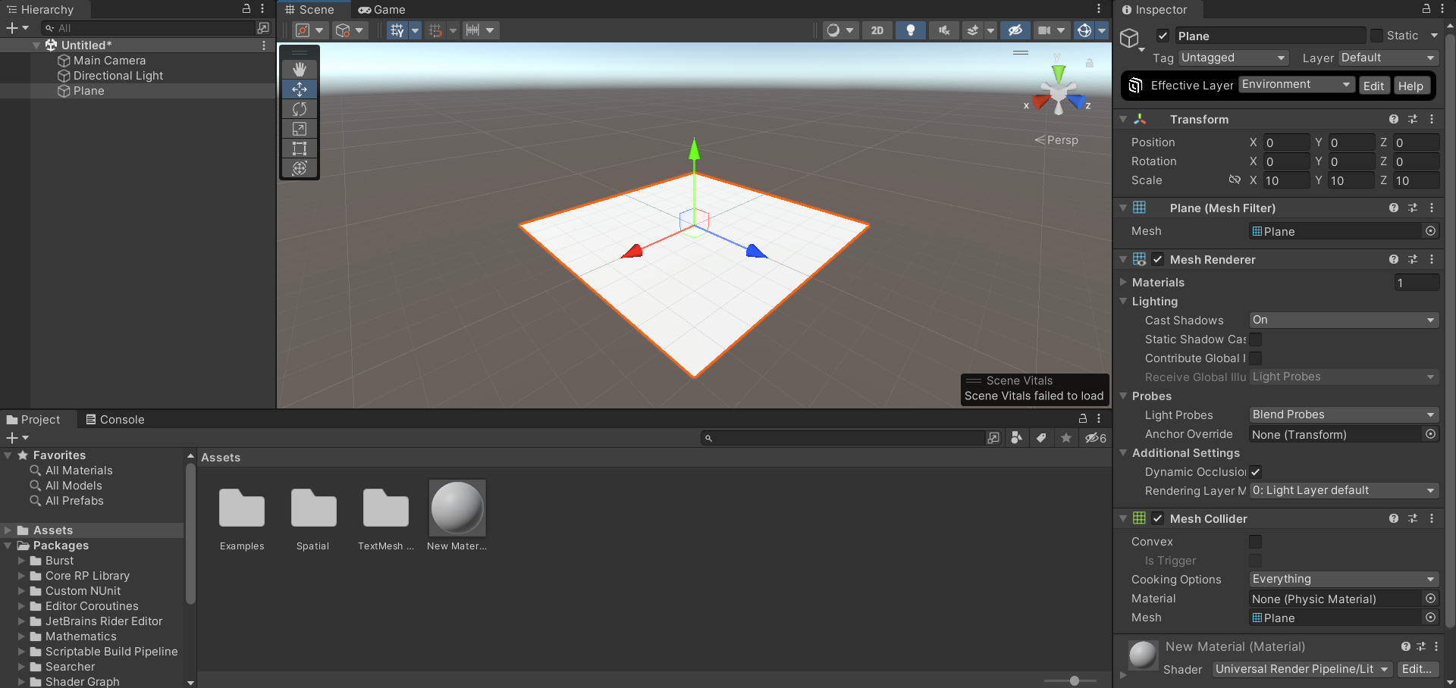
Simple 3D Objects Creating Simple 3D Objects
In your Assets directory, create a new Material. Right click, and select Create > Material.
Then, drag and drop it on your desired object in the scene.

Slide 9
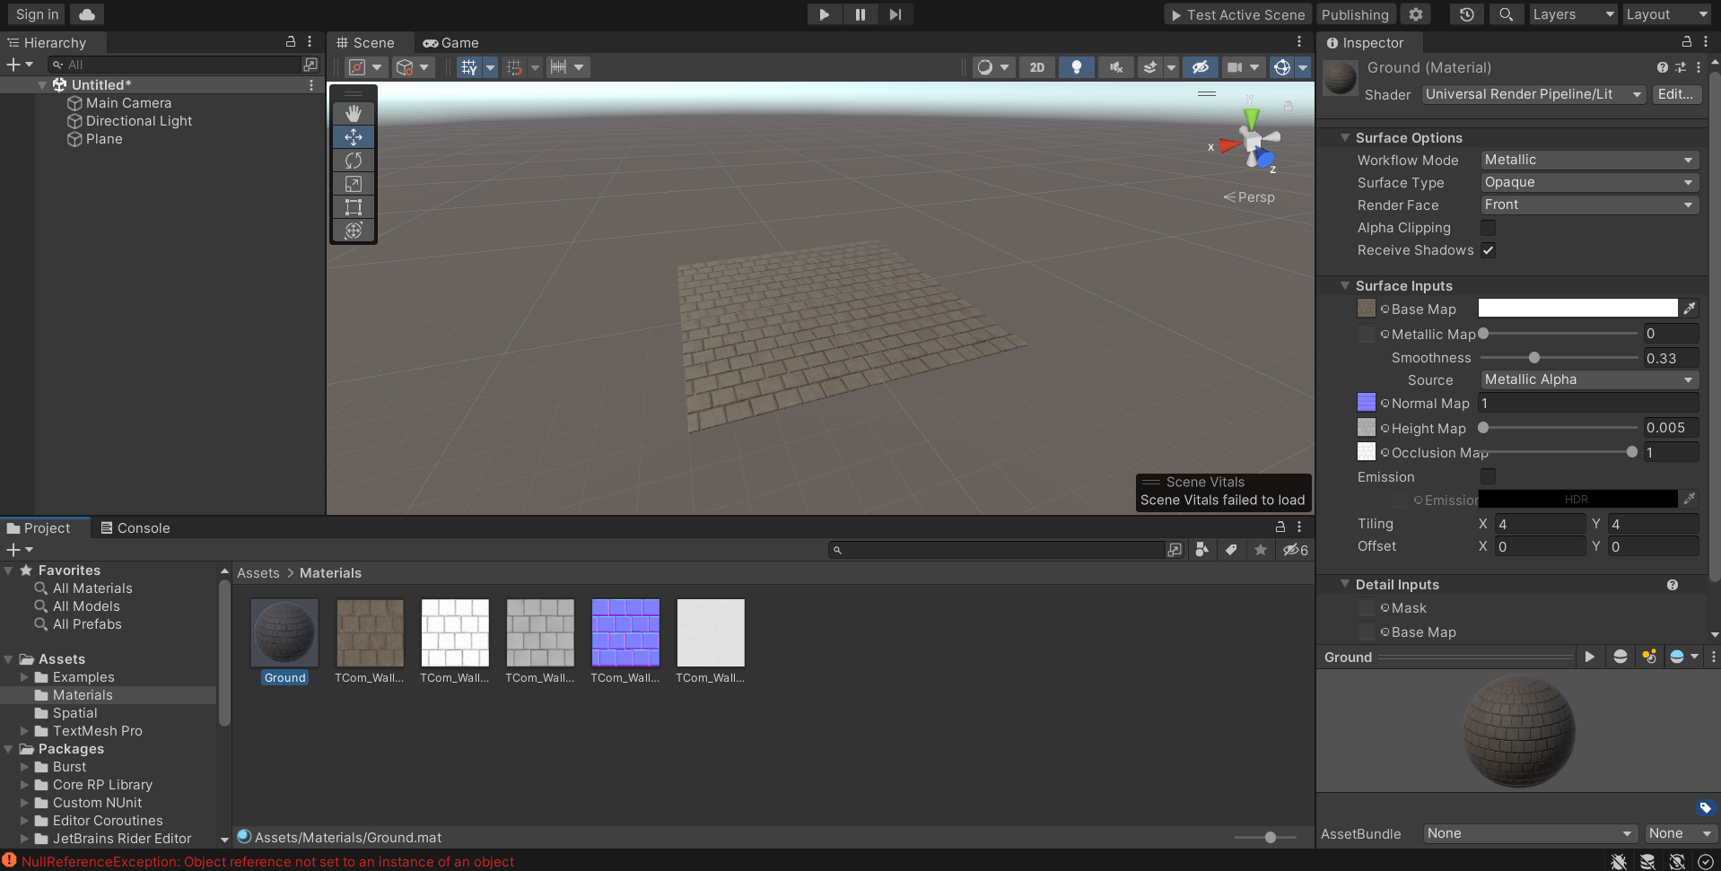
Simple 3D Objects Creating Simple 3D Objects
Then we can customize the material however we want.
Under Surface Inputs > Base Map, select a color or an image to set your material's base map to.
Then you can adjust things like metallic, smoothness, and tiling.
Here I found a Stone Wall texture on textures.com, which included albedo (base), normal, height, ambient occlusion, and roughness maps.

Slide 10
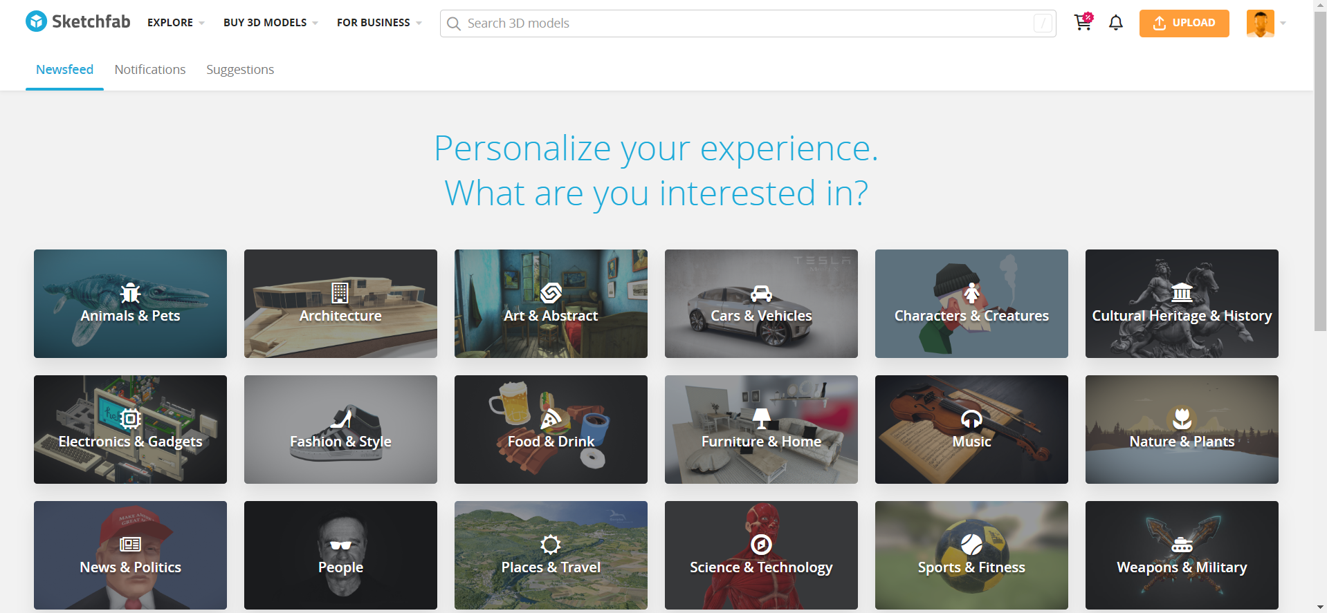
3D Models Finding 3D Models Online
3D models can be imported into Unity for use in Spatial Scenes. You can procure 3D models in several ways.
First, you can find 3D Models online that others have made and published for free use.
Look on sketchfab.com, turbosquid.com, free3d.com, and other sites.
Sketchfab

Slide 11
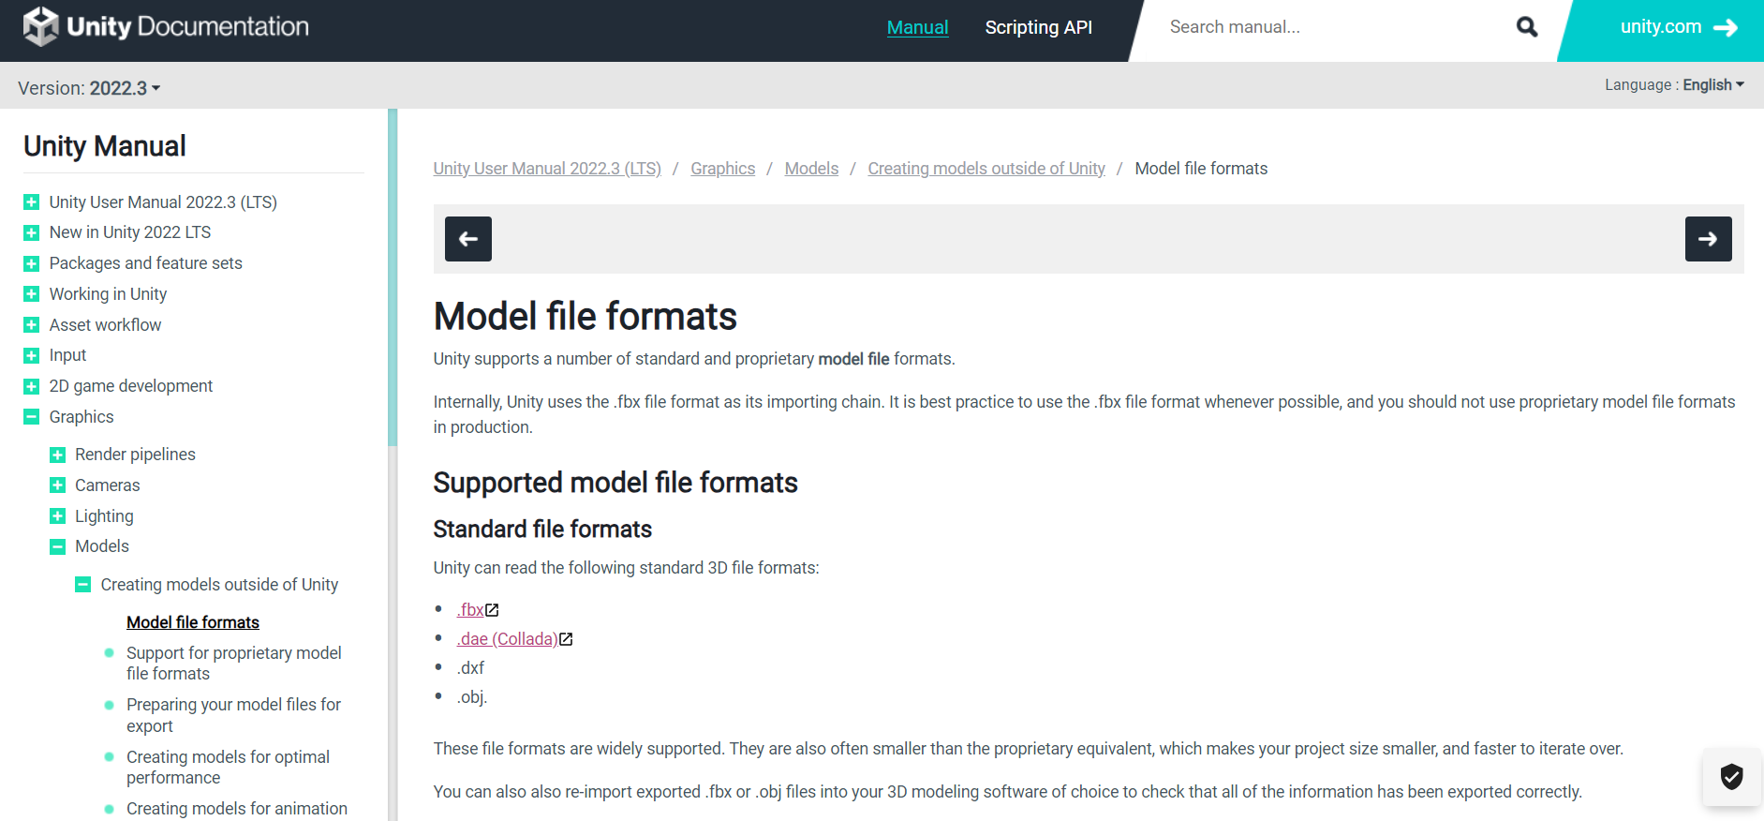
3D Models Object Compatibility with Unity
Objects can be found in many different file types. Only objects of certain file types are compatible with Unity:
.fbx
.dae
.dxf
.obj
For more information, look here.

Slide 12
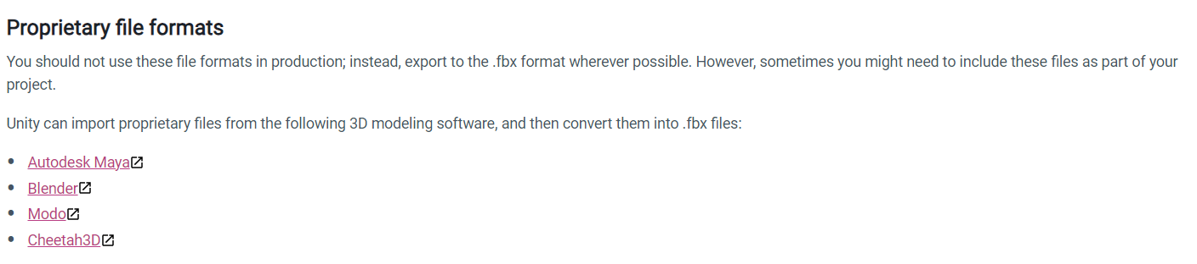
3D Models Object Compatibility with Unity
Unity can also read the file formats of certain 3D modeling software as .fbx files.
However, they recommend against this, because the respective modeling software must be installed for this to work.

Slide 13
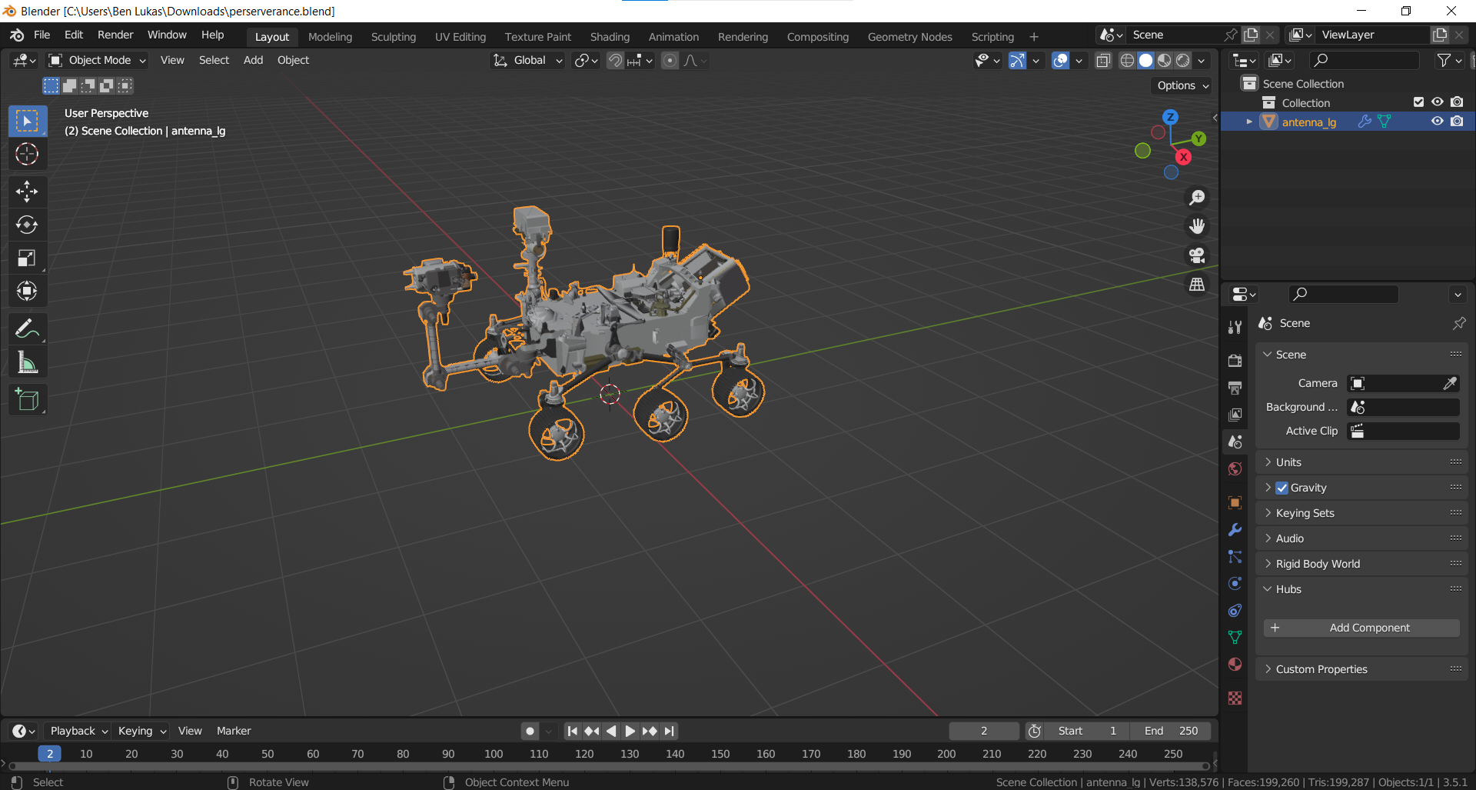
3D Models Creating 3D Models
Speaking of 3D modeling software, such software can be used to create 3D models of your own design. Although, making anything complicated takes quite a bit of knowledge and skill.
Many 3D modeling software companies, such as Blender, provide documentation for their product, and many tutorials can be found online.
Blender

Slide 14
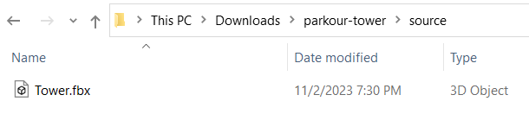
3D Models Importing 3D Models
Unity's documentation for importing models
Once you have a 3D model you would like to use for your Spatial project, make sure you have it in .fbx format.
You can use Blender to change the file format of a model if needed.

Slide 15
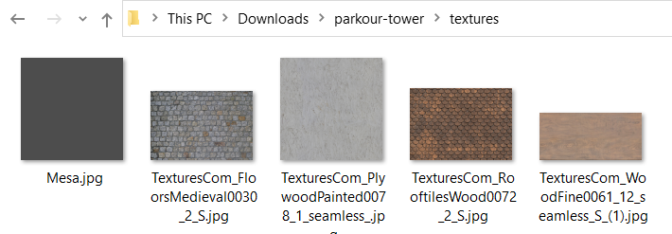
3D Models Importing 3D Models
You will also want to make sure you have the model's associated textures, in .png or .jpg formats.

Slide 16
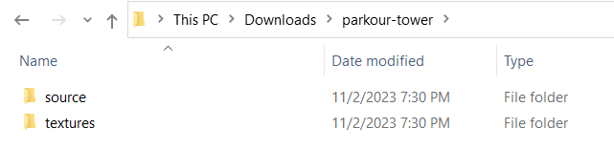
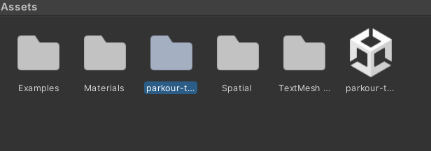
3D Models Importing 3D Models
The folder "parkour-tower" contains the 3D model (in "source") and its textures.
Make sure that the 3D Model and its textures are inside a common parent folder. You should import this parent folder in full into Unity.

Slide 17
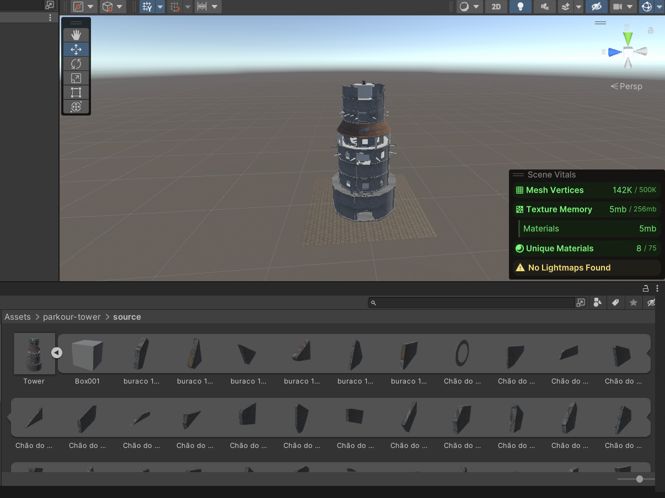
3D Models Importing 3D Models
Now, in Unity, you can find your 3D model in your Assets and drag it into the scene.
Since the model shares a folder with its own textures Unity should recognize these textures and immediately apply them to the object's materials.

Slide 18
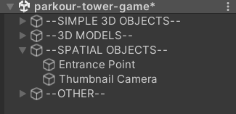
Spatial Objects Types of Spatial Objects
The Spatial Unity SDK adds multiple different kinds of Spatial objects.
Some of them are required in your scene in order to publish/test it in Spatial:
Entrance Point
Thumbnail Camera
For more information, see my documentation on creating Custom Spaces.

Slide 19
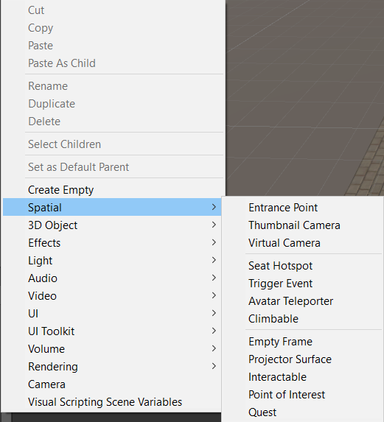
Spatial Objects Types of Spatial Objects
Other Spatial Objects:
Virtual Camera – Overrides the default main camera in Spatial
Seat Hotspot – Applied to a chair object; Allows a user to sit
Trigger Event – Invokes a Spatial event when an object enters its radius
Avatar Teleporter – Teleports the user to the Target upon entering
Projector Surface – Allows a user to share their screen on a surface
Empty Frame – A frame that users can fill with images, docs, etc.
Interactable – Allows interaction in Spatial; Useful for scripting (We will cover this next)
The list of Spatial objects in Unity

Slide 20
Spatial Objects Types of Spatial Objects
Most of these Spatial objects are quite intuitive to use.
Some of these objects are meant to stand alone, such as Entrance Point, Thumbnail/Virtual Camera, and Avatar Teleporter.
Others make more sense when they are the child of another object. For example, Seat Hotspot, Projector Surface, Climbable, and Interactable.
The list of Spatial objects in Unity

Slide 21
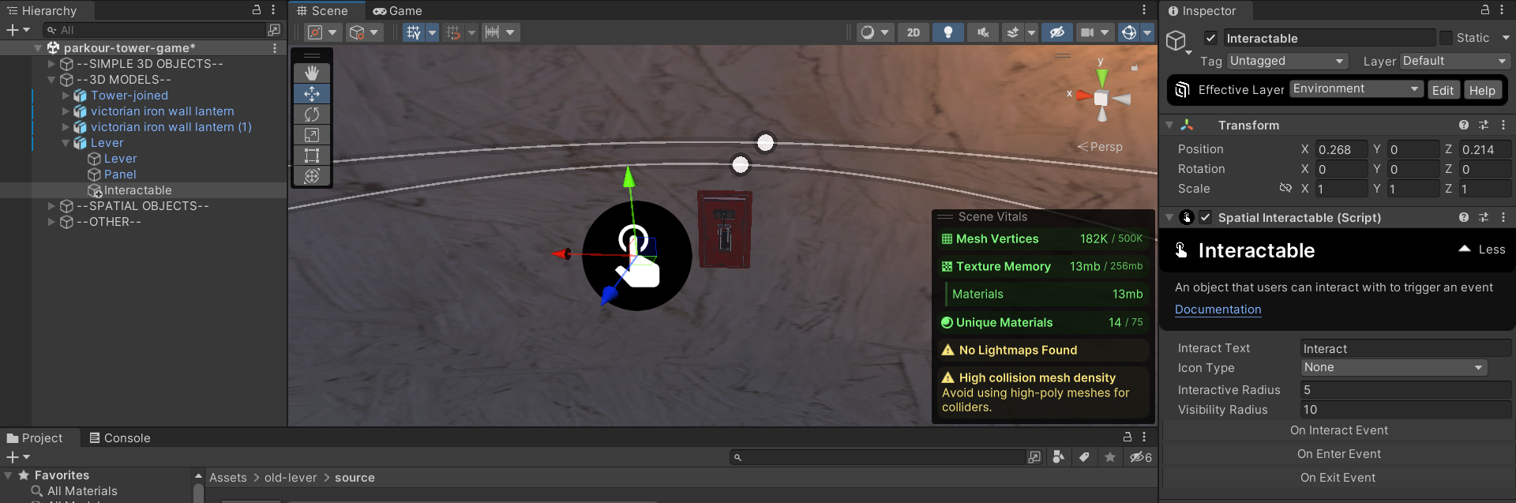
Spatial Objects Interactable Objects
The Spatial Object Interactable is a unique one. The Interactable Object is meant to be used for scripting purposes.
Apply the Interactable Object as a child to another object.

Slide 22
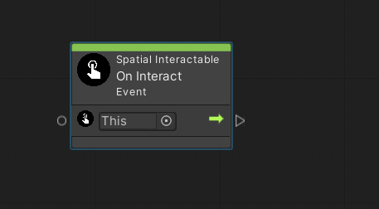
Spatial Objects Interactable Objects
Apply a visual script to the object that has the Interactable child.
In the script we can use an interaction with the Interactable object as an event. Search "Spatial Interactable" in your script graph and select "On Interact".

Slide 23
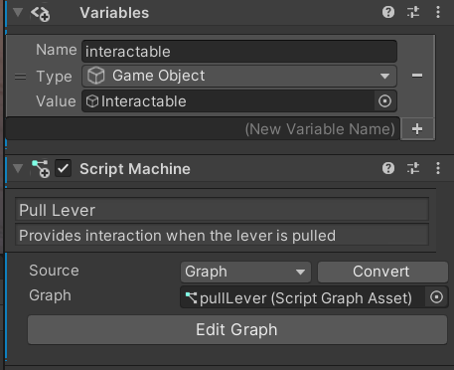
Spatial Objects Interactable Objects
You can add the object's Interactable child as an Object Variable for your script graph.
Pass it to your script graph as a GameObject type.

Slide 24
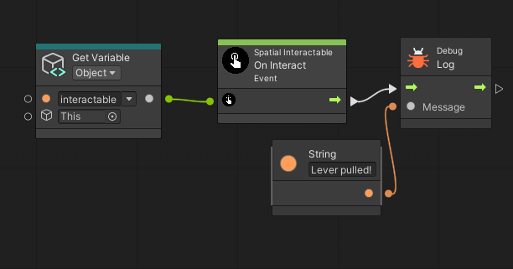
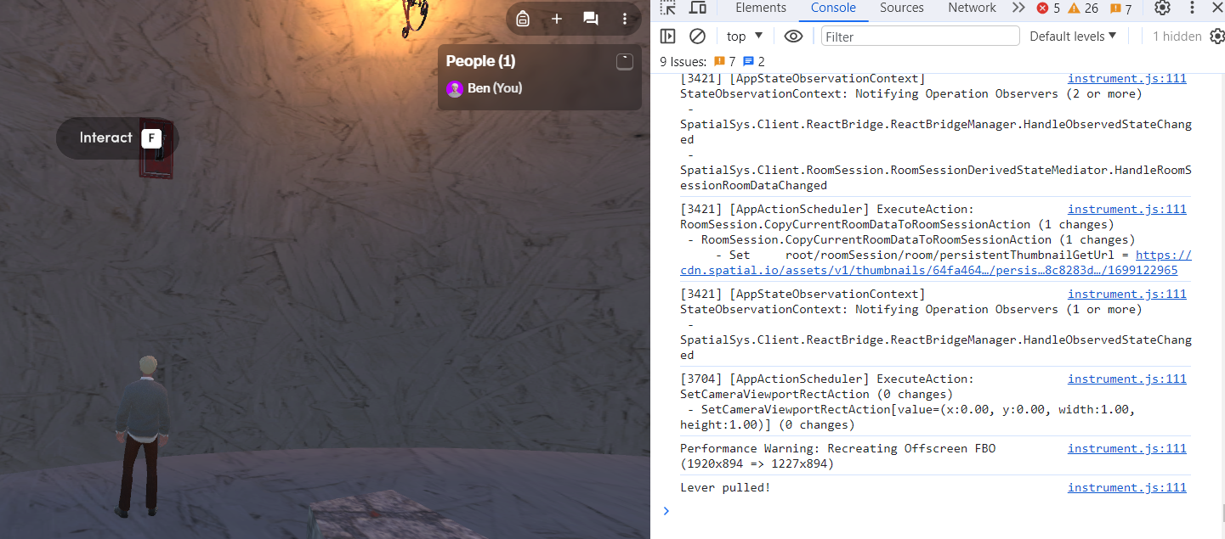
Spatial Objects Interactable Objects
With the On Interact node and the Interactable object as an Object Variable, we can use the Interactable object to do whatever we want in the visual script.

Slide 25
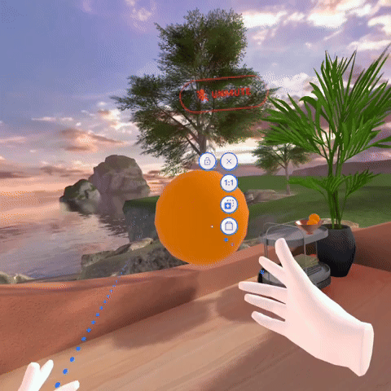
Spatial Objects Spatial Prefab Objects
Another very important type of Spatial Object is Spatial Prefab Objects.
If you have used Spatial before, you have undoubtedly encountered these objects.
I cover these objects in detail in my documentation about custom Scripts for Spatial.
The Spatial Prefab Object of an orange in your Home Space

